Slide 1
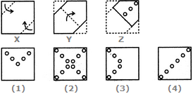
PAPER CUTTING
Q 1. Choose a figure which would most closely resemble the unfolded form of Figure (Z).
A.1 B.2 C.3 D.4

Slide 2
PAPER CUTTING
Q 1. Choose a figure which would most closely resemble the unfolded form of Figure (Z).
A.1 B.2 C.3 D.4

Slide 3
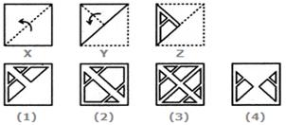
PAPER CUTTING
Q 2. Choose a figure which would most closely resemble the unfolded form of Figure (Z).
A.1 B.2 C.3 D.4

Slide 4
PAPER CUTTING
Q 2. Choose a figure which would most closely resemble the unfolded form of Figure (Z).
A.1 B.2 C.3 D.4

Slide 5
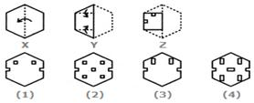
PAPER CUTTING
Q 3. Choose a figure which would most closely resemble the unfolded form of Figure (Z).
A.1 B.2 C.3 D.4

Slide 6
PAPER CUTTING
Q 3. Choose a figure which would most closely resemble the unfolded form of Figure (Z).
A.1 B.2 C.3 D.4

Slide 7
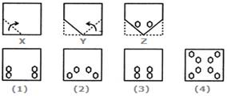
PAPER CUTTING
Q 4. Choose a figure which would most closely resemble the unfolded form of Figure (Z).
A.1 B.2 C.3 D.4

Slide 8
PAPER CUTTING
Q 4. Choose a figure which would most closely resemble the unfolded form of Figure (Z).
A.1 B.2 C.3 D.4

Slide 9
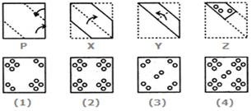
PAPER CUTTING
Q 5. Choose a figure which would most closely resemble the unfolded form of Figure (Z).
A.1 B.2 C.3 D.4

Slide 10
PAPER CUTTING
Q 5. Choose a figure which would most closely resemble the unfolded form of Figure (Z).
A.1 B.2 C.3 D.4

Slide 11
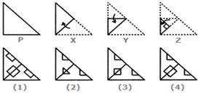
PAPER CUTTING
Q 6. Choose a figure which would most closely resemble the unfolded form of Figure (Z).
A.1 B.2 C.3 D.4

Slide 12
PAPER CUTTING
Q 6. Choose a figure which would most closely resemble the unfolded form of Figure (Z).
A.1 B.2 C.3 D.4

Slide 13
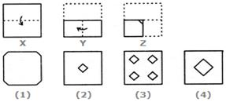
PAPER CUTTING
Q 7. Choose a figure which would most closely resemble the unfolded form of Figure (Z).
A.1 B.2 C.3 D.4

Slide 14
PAPER CUTTING
Q 7. Choose a figure which would most closely resemble the unfolded form of Figure (Z).
A.1 B.2 C.3 D.4

Slide 15
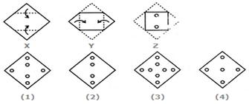
PAPER CUTTING
Q 8. Choose a figure which would most closely resemble the unfolded form of Figure (Z).
A.1 B.2 C.3 D.4

Slide 16
PAPER CUTTING
Q 8. Choose a figure which would most closely resemble the unfolded form of Figure (Z).
A.1 B.2 C.3 D.4

Slide 17
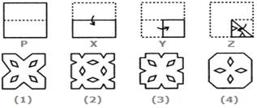
PAPER CUTTING
Q 9. Choose a figure which would most closely resemble the unfolded form of Figure (Z).
A.1 B.2 C.3 D.4

Slide 18
PAPER CUTTING
Q 9. Choose a figure which would most closely resemble the unfolded form of Figure (Z).
A.1 B.2 C.3 D.4

Slide 19
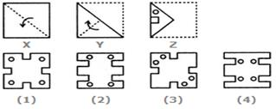
PAPER CUTTING
Q 10. Choose a figure which would most closely resemble the unfolded form of Figure (Z).
A.1 B.2 C.3 D.4

Slide 20
PAPER CUTTING
Q 10. Choose a figure which would most closely resemble the unfolded form of Figure (Z).
A.1 B.2 C.3 D.4

Slide 21
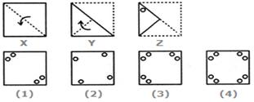
PAPER CUTTING
Q 11. Choose a figure which would most closely resemble the unfolded form of Figure (Z).
A.1 B.2 C.3 D.4

Slide 22
PAPER CUTTING
Q 11. Choose a figure which would most closely resemble the unfolded form of Figure (Z).
A.1 B.2 C.3 D.4

Slide 23
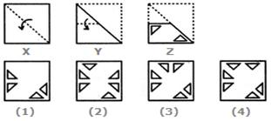
PAPER CUTTING
Q 12. Choose a figure which would most closely resemble the unfolded form of Figure (Z).
A.1 B.2 C.3 D.4

Slide 24
PAPER CUTTING
Q 12. Choose a figure which would most closely resemble the unfolded form of Figure (Z).
A.1 B.2 C.3 D.4

Slide 25
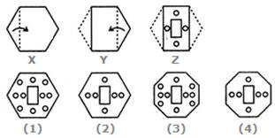
PAPER CUTTING
Q 13. Choose a figure which would most closely resemble the unfolded form of Figure (Z).
A.1 B.2 C.3 D.4

Slide 26
PAPER CUTTING
Q 13. Choose a figure which would most closely resemble the unfolded form of Figure (Z).
A.1 B.2 C.3 D.4

Slide 27
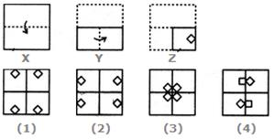
PAPER CUTTING
Q 14. Choose a figure which would most closely resemble the unfolded form of Figure (Z).
A.1 B.2 C.3 D.4

Slide 28
PAPER CUTTING
Q 14. Choose a figure which would most closely resemble the unfolded form of Figure (Z).
A.1 B.2 C.3 D.4

Slide 29
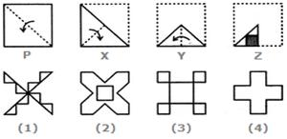
PAPER CUTTING
Q 15. Choose a figure which would most closely resemble the unfolded form of Figure (Z).
A.1 B.2 C.3 D.4

Slide 30
PAPER CUTTING
Q 15. Choose a figure which would most closely resemble the unfolded form of Figure (Z).
A.1 B.2 C.3 D.4

Slide 31
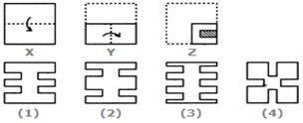
PAPER CUTTING
Q 16. Choose a figure which would most closely resemble the unfolded form of Figure (Z).
A.1 B.2 C.3 D.4

Slide 32
PAPER CUTTING
Q 16. Choose a figure which would most closely resemble the unfolded form of Figure (Z).
A.1 B.2 C.3 D.4

Slide 33
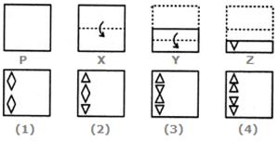
PAPER CUTTING
Q 17. Choose a figure which would most closely resemble the unfolded form of Figure (Z).
A.1 B.2 C.3 D.4

Slide 34
PAPER CUTTING
Q 17. Choose a figure which would most closely resemble the unfolded form of Figure (Z).
A.1 B.2 C.3 D.4

Slide 35
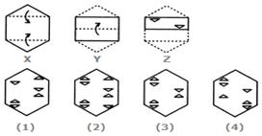
PAPER CUTTING
Q 18. Choose a figure which would most closely resemble the unfolded form of Figure (Z).
A.1 B.2 C.3 D.4

Slide 36
PAPER CUTTING
Q 18. Choose a figure which would most closely resemble the unfolded form of Figure (Z).
A.1 B.2 C.3 D.4

Slide 37
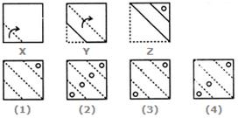
PAPER CUTTING
Q 19. Choose a figure which would most closely resemble the unfolded form of Figure (Z).
A.1 B.2 C.3 D.4

Slide 38
PAPER CUTTING
Q 19. Choose a figure which would most closely resemble the unfolded form of Figure (Z).
A.1 B.2 C.3 D.4

Slide 39
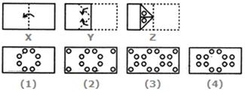
PAPER CUTTING
Q 20. Choose a figure which would most closely resemble the unfolded form of Figure (Z).
A.1 B.2 C.3 D.4

Slide 40
PAPER CUTTING
Q 20. Choose a figure which would most closely resemble the unfolded form of Figure (Z).
A.1 B.2 C.3 D.4

